Slide 1

Data and Statistics
DSLA Course
Rohit Padebettu

Slide 2
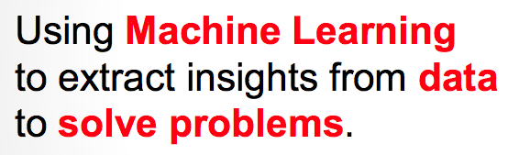
Ultimate Goal of a Data Scientist
Is not to build models!

Slide 3
Problem-Solving Critical Thinking
Many mistakes boil down to one of the gotchas we’ll cover today
Gotchas are the building blocks of critical thinking
Critical thinking is key in many jobs
Critical thinking is key to divergent thinking
Problem–solvers must be critical thinkers, therefore…
Great way to get noticed and ace interviews

Slide 4
Data Quality Issues
Data scientists spend 60% of their time cleaning data!
Incomplete
lacking attribute values
lacking certain attributes of interest
containing only aggregate data
Noisy
Containing Errors
Salary = -$1000
Containing Outliers
Inconsistent
Containing discrepancies in codes or names
Rating was 1-5 then A,B,C
Discrepancies in duplicate records

Slide 5
Data Quality
Reliable Models are built on top of High Quality Data
Potential Quality Metrics
Quality Metrics

Slide 6
Data Consistency
Refers to the usability of data
Requires measures to prevent
Corrupted files
Incomplete records
Incomplete transactions (such as due to a system failure)

Slide 7
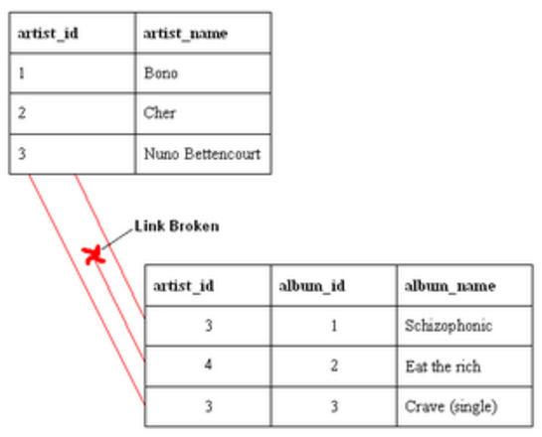
Data Referential Integrity
Data Integrity refers to accuracy & reliability

Slide 8
Sampling Bias
Usually a result of systematic error in sampling
Fixes
Get better, more Representative Samples
Aggregate Data with new factors

Slide 9
Confirmation Bias
Preferential search for evidence that confirms our conclusion
Where
Data Collection
Analysis
Interpretation
Why
Consciously
Unconsciously
How
Overfitting
Cherry Picking
Groupthink
Notes:
If we preferentially search for evidence that confirms our preferred conclusion
Contradicting evidence
Other conclusions
Can happen in data collection, analysis, and interpretation
Happens consciously and subconsciously
How?
Overfitting
Cherry-picking
Flawed pre-processing
Groupthink

Slide 10
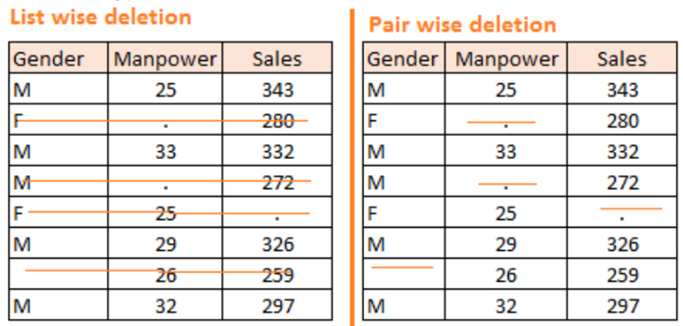
Handling Incomplete Data
Difficulties
May introduce bias
Or
Not make sense
Fixes
Imputation Average/KNN
Or
Build a model to predict it

Slide 11
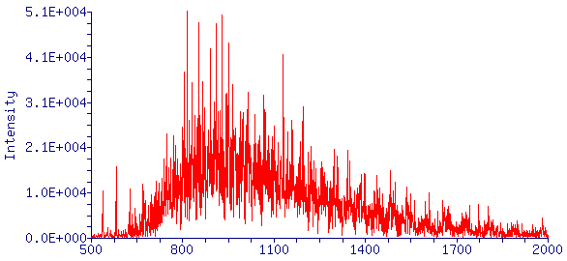
Handling Noisy Data
Random error or variance in measure attribute
Fixes
Binning followed by smoothening within bins
Regression Smoothening
Clustering to remove outliers
Human Inspection !!

Slide 12
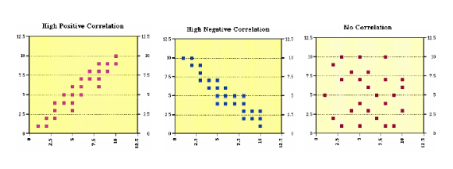
Handling Redundant Data
Duplicate or Equivalent Data
Difficulties
Can be source of overfitting
Fixes
Correlation Analysis of Variables

Slide 13
Handling Imbalanced Class Data
Fixes
Stratified Sampling
Weighting
Consider Precision/ Recall/F1, ROC Curve in addition to Accuracy
Oversampling minor class
Under-sampling major class
Algorithm Choice
Accuracy Paradox!
Remember this from LDA discussion?
97.2% Accuracy – not bad huh!!

Slide 14
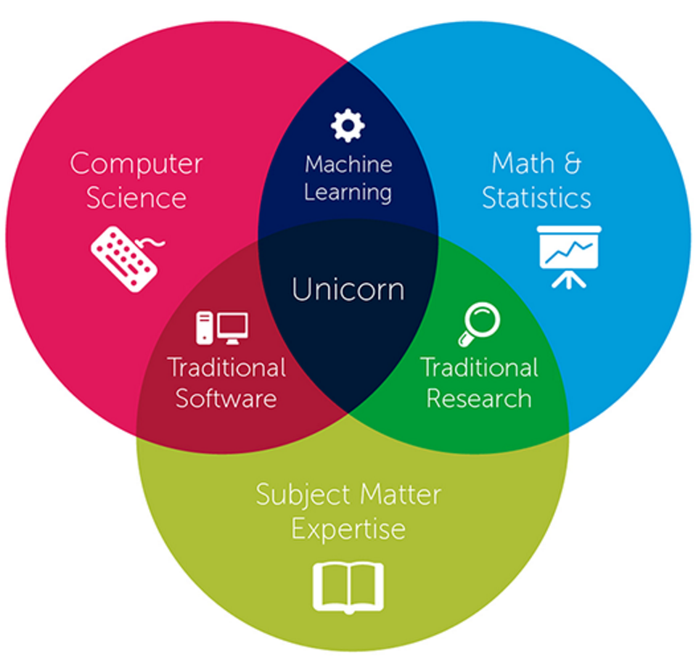
Who is a Data Scientist?
We used this in learning R & Big Data Tech
We Began here
Last Class we learnt something here
We will end back here

Slide 15
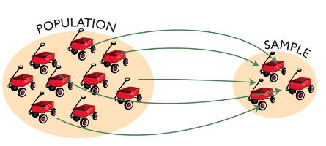
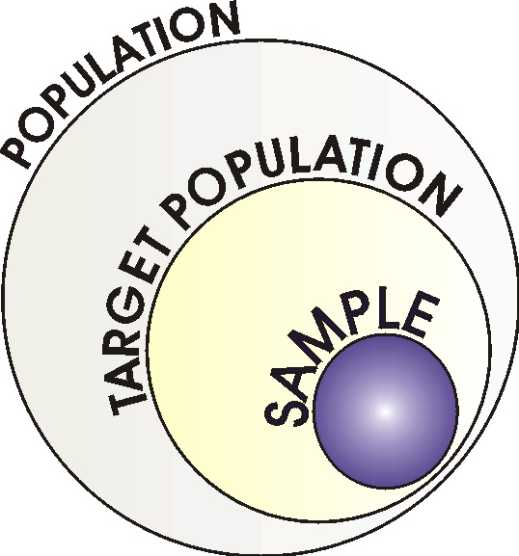
Sample vs Population
Remember: We usually analyze samples not populations
Assumptions
For inferential statistics to hold, sample should be representative of the population

Slide 16
Language of Statistics – Null Hypothesis
Null Hypothesis
It is usually the opposite of what you want to prove

Slide 17
Language of Statistics- Z Score
Z Score calculates how many standard deviations an element is from the mean
Z Scores
Higgs Boson : 5 sigma event
1 in 3.5 Million chance of data occurring by chance rather than from the Higgs Boson truly existing

Slide 18
Language of Statistics – P Value
It is the probability of observed event or more extreme event being due to chance
P Values

Slide 19
Language of Statistics – T test
Compares two samples to see if there is a “significant” difference between them
T Test
Null Hypothesis is always both samples are same mean

Slide 20
Central Limit theorem
Means of samples drawn from a population, following any distribution, is normally distributed
In Machine Learning this is the basis for
Cross Validation
Bagging
Averaging results of Models

Slide 21
Law of Large Numbers
As sample size grows, it’s average will get closer to that of the population
Larger number of observations in a sample “might” make it representative of the population

Slide 22
Law of Small Numbers
This is a Myth! There is no law of small numbers
Gambler’s Fallacy
General rules of probability hold in the long run. In short run events are random

Slide 23
Bias Variance Problem
Under fitting leads to overly simplified models which haven’t learned all the patterns in the data.
Overfitting leads to increased model complexity which leads to a variance problem as the model learns the noise in the data.

Slide 24
Bias Variance Problem
To Reduce Variance
Get more data
Reduce Features
Regularization
Pruning
Ensemble Models
To Reduce Bias
Obtain more features
More data – but it doesn’t help beyond a point
The key is pay attention to difference between training set error and test/validation set error

Slide 25
Regularization
To prevent overfitting, this adds a “Penalty Term” to the loss function
L1 Norm LASSO Regularization
LASSO can be used to do feature selection
L2 Norm Ridge Regularization

Slide 26
Last Slide
Hope you enjoyed as much as I did !

